Slide 1


Analysis of EV Charge points and cars
Company NameThe EV Plot
Date
Team A - Abdul, Arphaxad, Sam, Swathi, Raphael

Slide 2





Team A
Raphael
Swathi
Title: Head of Mapping
Title: Head of Pricing
Arphaxad
Abdul
Sam
Title: Head of Availability
Title: Head of Car Analysis
Title: Head of Dashboard

Slide 3

The Journey - EV charge point and car markets
Date
1
2
3
4
Opportunity
Challenges
Dashboard tool
Conclusions
Overview of EV market growth and the scale of the opportunity
Overview of problems caused by EV growth and the industry challenges to overcome this
How our analysis aims to tackle these issues and the insights we derive through interactive analysis of:
Mapping
Pricing
Availability
EV Car market
Core insights and next steps for progressing the solution to facilitate a viable product

Slide 4
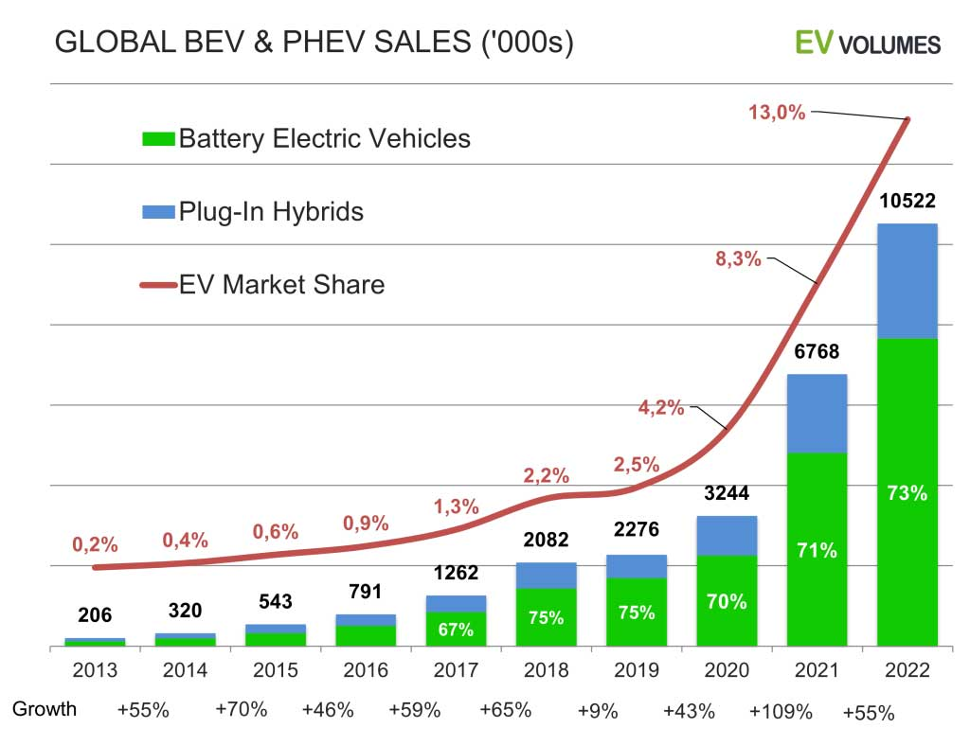
The Opportunity - EV Car Market Sales Growth
The EV market has experienced explosive expansion in the past 10 to 15 years
YoY growth is on average above 50% and has exceeded 100% at times
EVs and Plug-in Hybrids now represent a 13% global market share

Slide 5
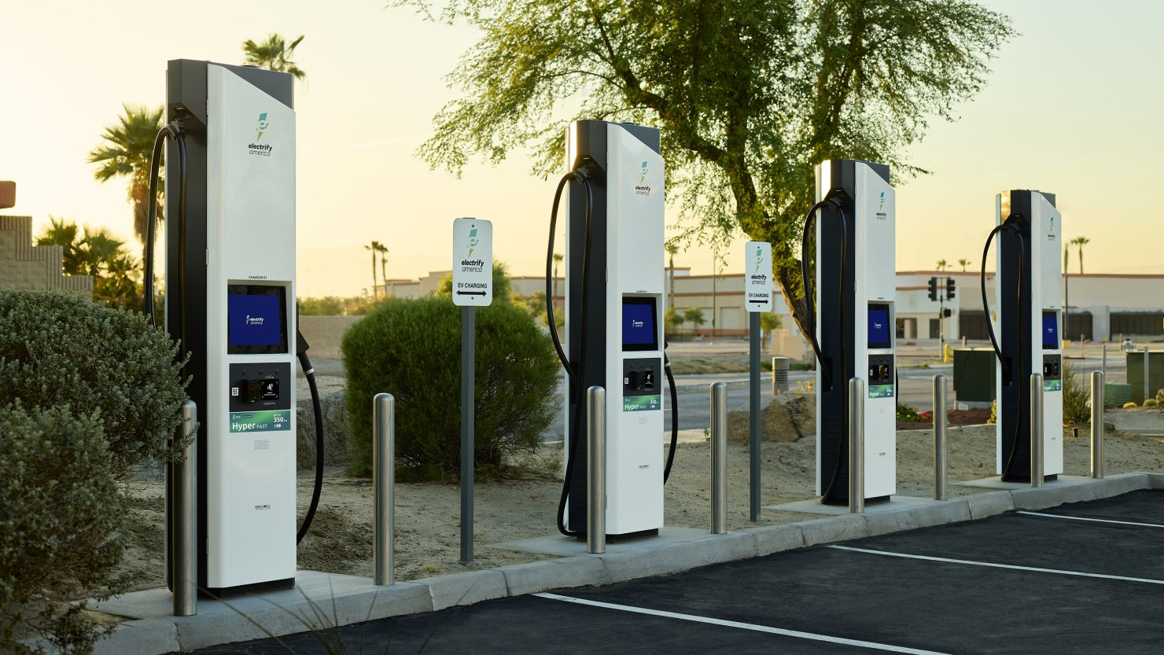
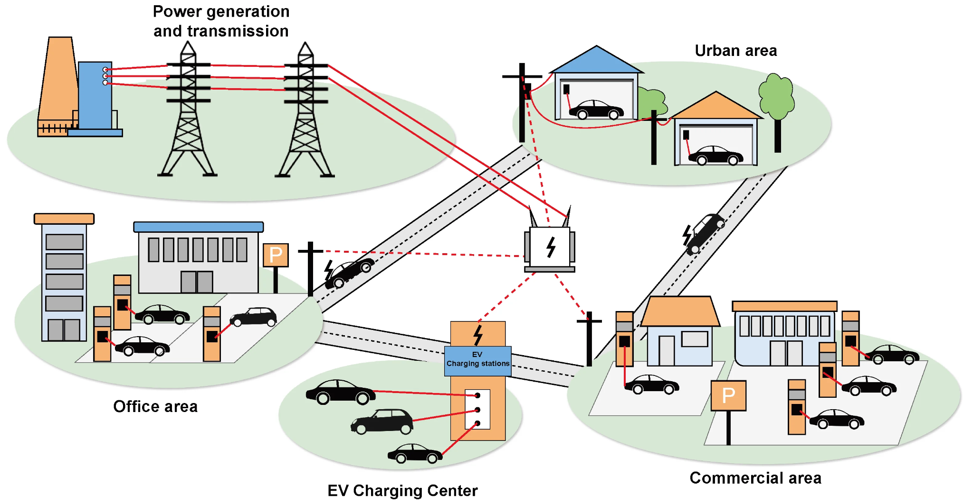
EV Market Growth – Core Challenges
The explosive uptake of EV vehicles across the globe has created a set of unique challenges.
Our bespoke mapping and pricing analysis tool aims to help alleviate these challenges with clear, insightful and impactful data analysis to facilitate an ambitious but smooth industry growth
Core Industry Challenges:
Customers: dealing with ‘range fear’ and finding available charge points with sufficient charging speed and with cost transparency.
Electricity grid providers: ensuring they can provide delivery of the additional power required to facilitate charge point installations
Charge Point Installers: finding new sites where both grid power and customers can be sourced to support a strong business model.

Slide 6


EV Plot - Our Dashboard’s Core Business Streams
The dashboard
1.
Mapping EV Charge Points
2. Charge Point Cost Analysis
3.
Charge Point Availability
4.
EV Car Market Analysis

Slide 7

Charge Point Types
3
DC Fast*
charge point types evaluated in the dashboard
AC Level 2
Ultra Fast
AC Level 1
Fast
Power: 50–350 kW or more (400–1000V DC).
Speed: Adds 180–240+ miles in ~30 minutes to an hour; 3–20 miles per minute.
Best For: Road trips and quick top-ups; requires compatible vehicles.
Power: 3.6–19.2 kW (208–240V AC)
Speed: Adds 10–60 miles per hour.
Best For: Daily drivers, most home charging, overnight charging for full EVs.
Slow
Power : 1.2–3 kW (120V AC)
Best for: Best For: Plug-in hybrids (PHEVs) or light EV use as a backup
*DC Charging is the fastest but also requires a 'converter' at the charge point connection point (extra cost to install) to convert grid electricity (AC) to car battery electricity (DC). Most cars also have an inbuilt converter meaning they can switch between charging options.

Slide 8
Our Data
EV charge point session data from over 1,000 charge points across the USA including data points such as time of charge, user type, charge point type, pricing, duration, power and energy consumed.
US cities geojson file for mapping city boundaries across Los Angeles, San Fran, Houston, Boston and New York.
EV car model data including price category, body shape, speed, range, battery size and more.
The EV charge points
The Location
The Cars
1,321
USA
477
Charging sessions
5 Major Cities
EV car models
No. of Charge Points Evaluated
Charge Point Types
AC Level 1
AC Level 2
DC Fast Charge
Chicago
Houston
Los Angeles
New York
San Francisco
225
246
269
239
239

Slide 9
1. Interactive Mapping
The map was mainly created using the Python library, Streamlit, alongside PyDeck to plot geospatial data.
Charge Points
Plotting the charge types on the interactive map
How can we best portray charge types on the map to maximise customer interactivity and useful information?
Location
Plotting city geojson files on the interactive map
What interactivity functions should we employ to help the customer search for charge points?
Info
Showing additional useful info on the interactive map
What additional information does the customer want to see on the map and hover functions?

Slide 10
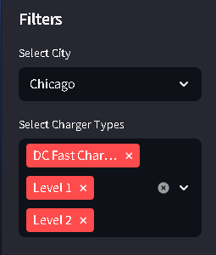


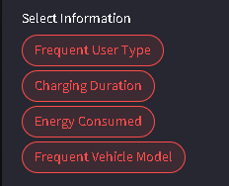

1. Interactive Mapping
Map View
Allows for information about a specific charging station to be displayed while cursor is on station
Filters
Input Type
City
Select Box
Charger Type
Multi Select
Information on Hover
Allows for information about a specific charging station to be displayed while cursor is on station
Filters
Input Type
Information
Pill Box
Central Tendency
Radio
Point Size
Radio

Slide 11
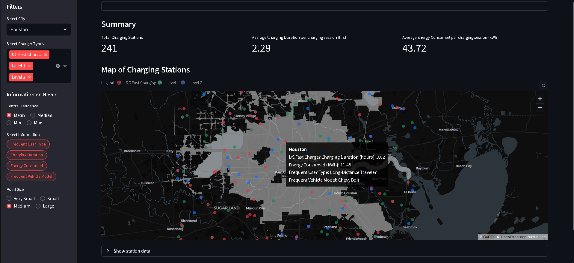
1. Interactive Mapping

Slide 12
2. Pricing Analysis
Charge Type
Evaluate and identify trends and patterns between charging costs and charger type
How does the charge type impact pricing?
Does the benefit of faster charging outweigh the additional costs involved?
Location
Locational or nodal pricing evaluation at a nationwide and district level
How does city choice impact pricing?
Are there district level pricing variances?
Where are the cheapest chargers?
Time
Briefly explain each challenge and its possible impact on sales, earnings, and so on.
How does unit price change over time?
What are the cheapest times of day to be charging?
Are time and pricing trends consistent across the country?

Slide 13
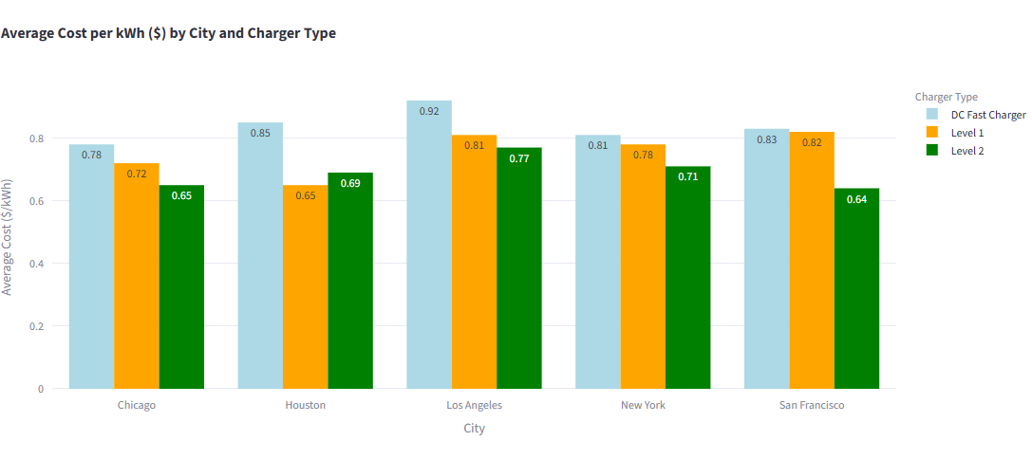
2. Pricing Analysis
Analysing average pricing across different cities and selected charge point types - see dashboard to explore interactive options
DC Charging tends to be the most expensive given it is the fastest and so requires the largest grid connection and most expensive cabling and connection equipment.
We can see there is a slight variance between city costs. This is because major U.S. electricity markets, use nodal pricing (Locational Marginal Pricing or LMP) to set different prices at thousands of grid "nodes" based on local supply, demand, and transmission congestion, reflecting real-time costs.

Slide 14
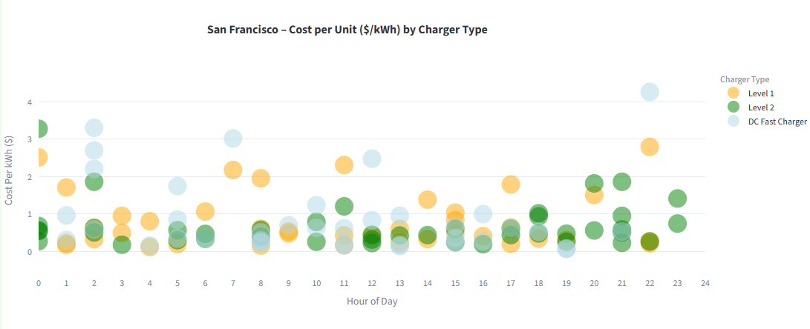
2. Pricing Analysis
Analysing average pricing over the day for a selected city and selected charge point types - see dashboard to explore interactive options

Slide 15
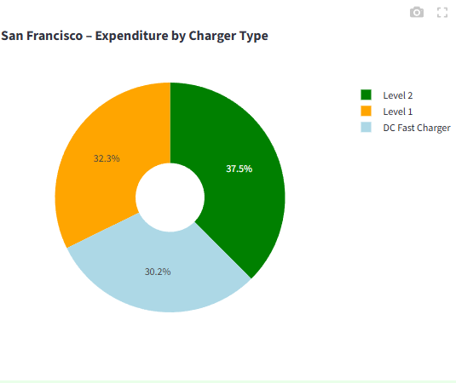
2. Pricing Analysis
Understanding the distribution of customer expenditrue across different charge point types in selected cities - see dashboard to explore interactive options

Slide 16
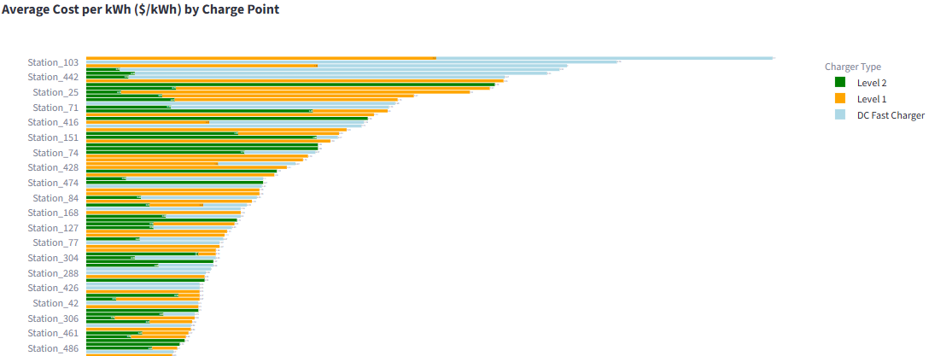
2. Pricing Analysis
Ranking specific charge points based on pricing in selected cities - see dashboard to explore interactive options

Slide 17
3. Availability Analysis
Charge Type
Evaluate and identify trends and patterns between charging times and charger type
How does the charge type impact utilisation rates?
Are different charge types used more often at certain times of day or throughout the week?
Location
Utilisation trends across different locations - nationwide and district level
How does location impact utilisation rates?
Does location impact user type utilisation?
User Type
Briefly explain each challenge and its possible impact on sales, earnings, and so on.
How does user type impact utlisation rates?
Do user groups follow charge patterns with respect to charing types and times?

Slide 18
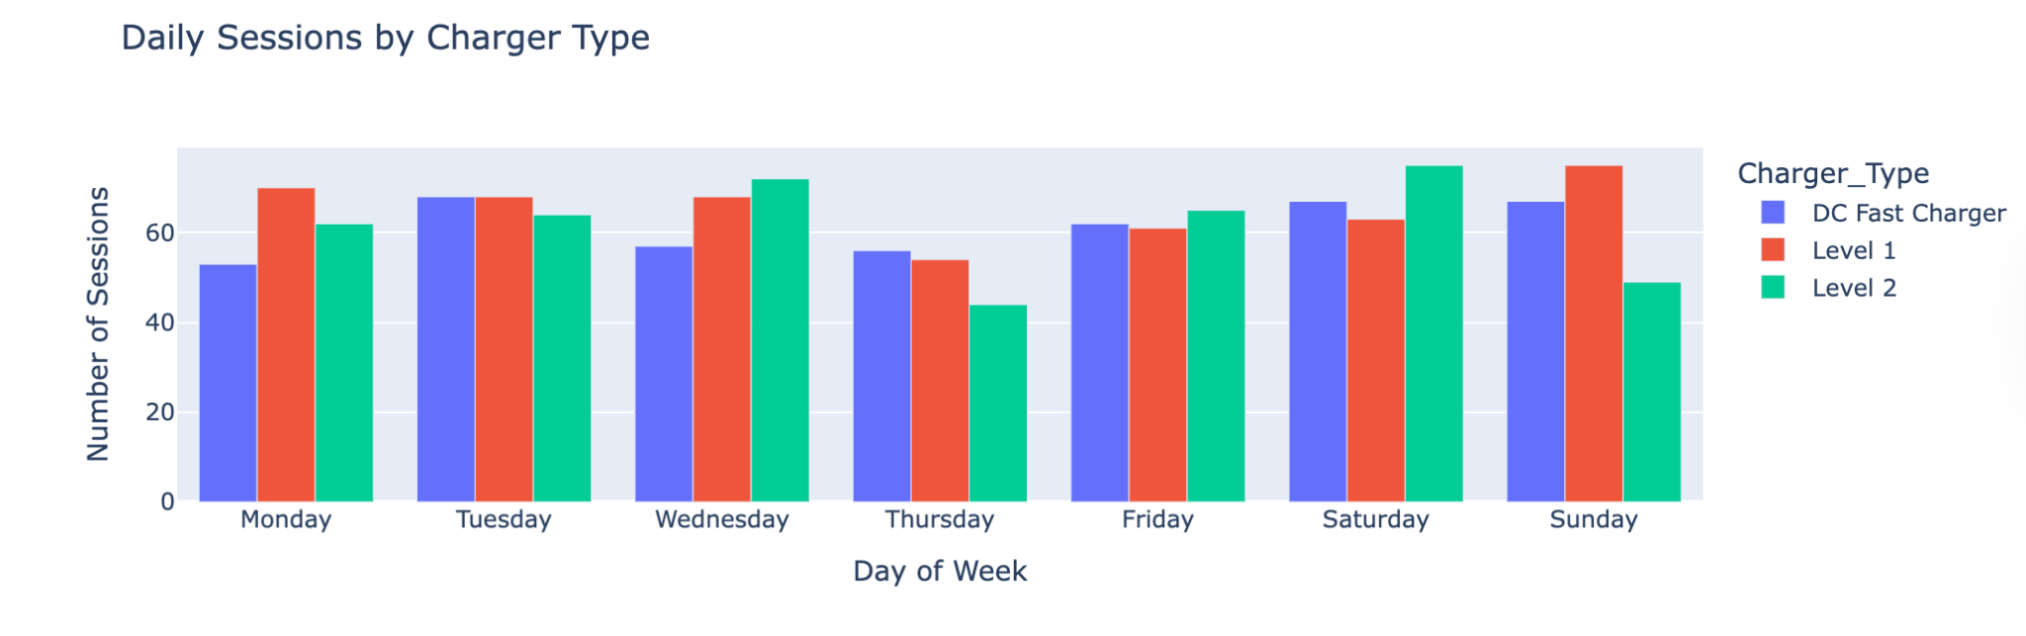
3. Availability Analysis
Charger-type comparisons by number of sessions per days of the week:
Thursday is the least active day .
All stations record < 60 sessions for each charger on Thursday
The only day that DC Fast charger tops with 56 sessions as shown on interactive dashboard

Slide 19
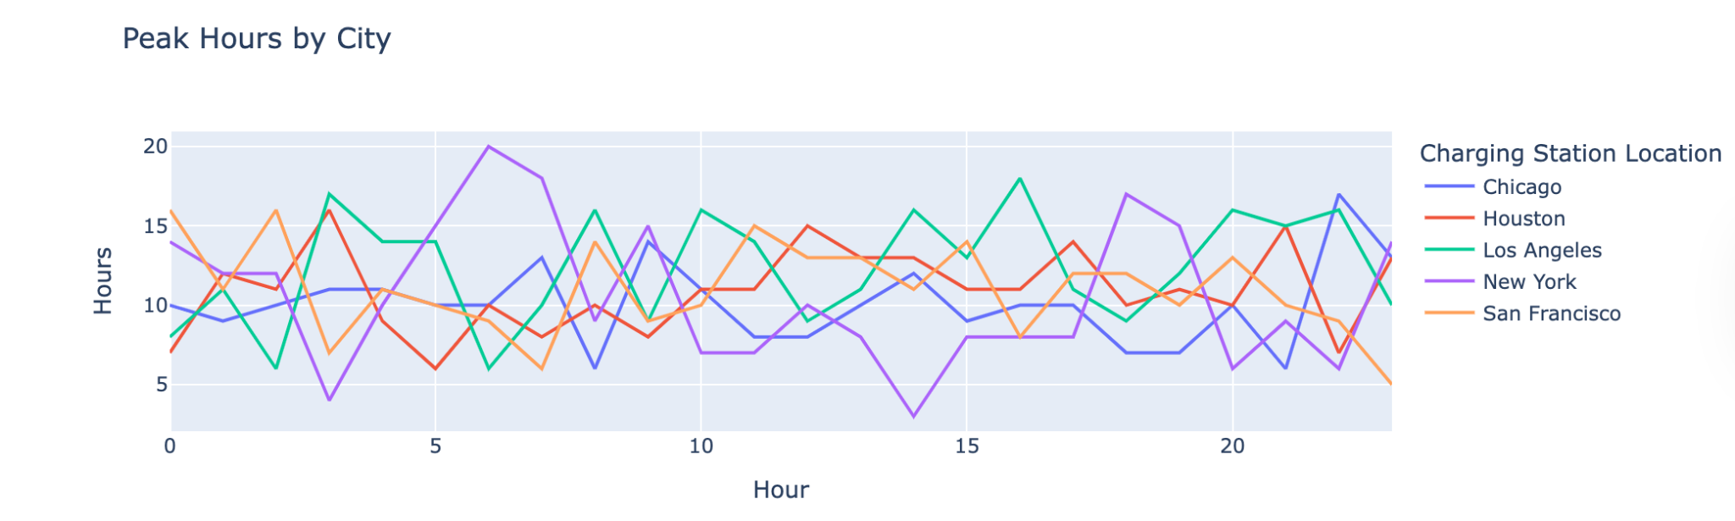
3. Availability Analysis
Peak hours: Understanding demand is crucial
Visualizing trends over time, showing how demand fluctuates hourly, daily, or monthly.
New york has both the highest and lowest peak.
Highest demand at at 0600 hrs.
Lowest demand at at 1400 hrs (as shown in the interactive dashboard.)
Prediction Model: This highlights the possibility of a prediction model to predict the availability of a charger at a particular time of the day.

Slide 20
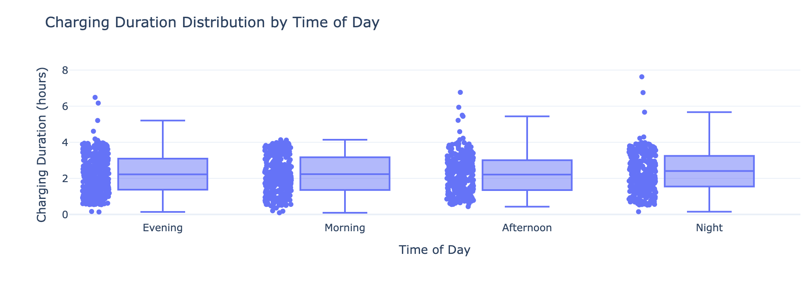
3. Availability Analysis
Usage patterns:
Charging duration in the morning is very symmetrically and tightly distributed around the median of 2.3 hrs .
Evening , afternoon and night sessions indicate varied charging duration hours (extended durations of upto 6 hrs due to outliers.)

Slide 21
3. EV car market
Company Name
Date
Car models
Download dataset of latest car models and provide high-level analysis
Which models are the most popular?
What trends can we find between models, pricing and efficiency?
Performance Metrics
Assess pricing dynamics and patterns in relation to charging capabilities, range and efficiency
How does pricing impact efficiency?
How does pricing impact charging capabilities?
Charging Pricing
Evaluate the cost of running selected vehicles in selected locations
Which cars are most efficient to run in and which cities?

Slide 22
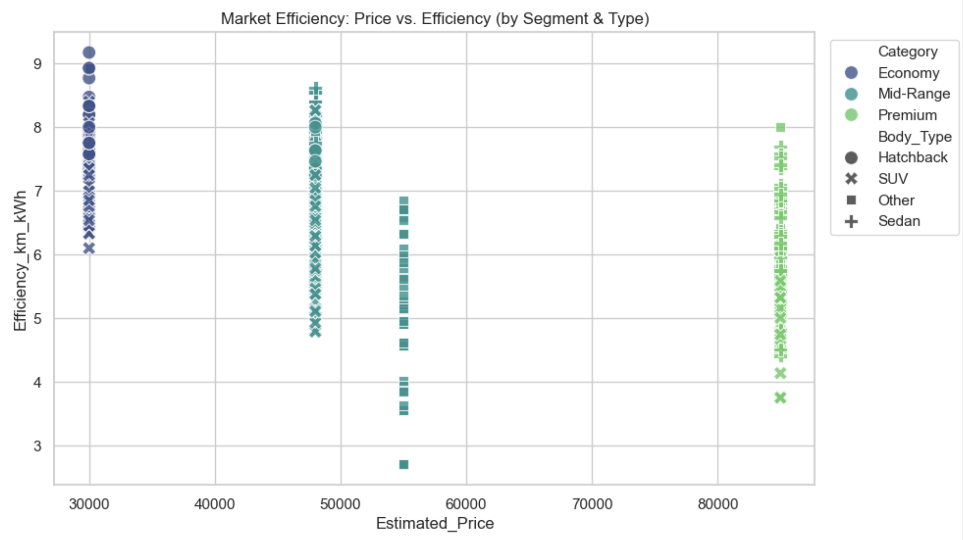
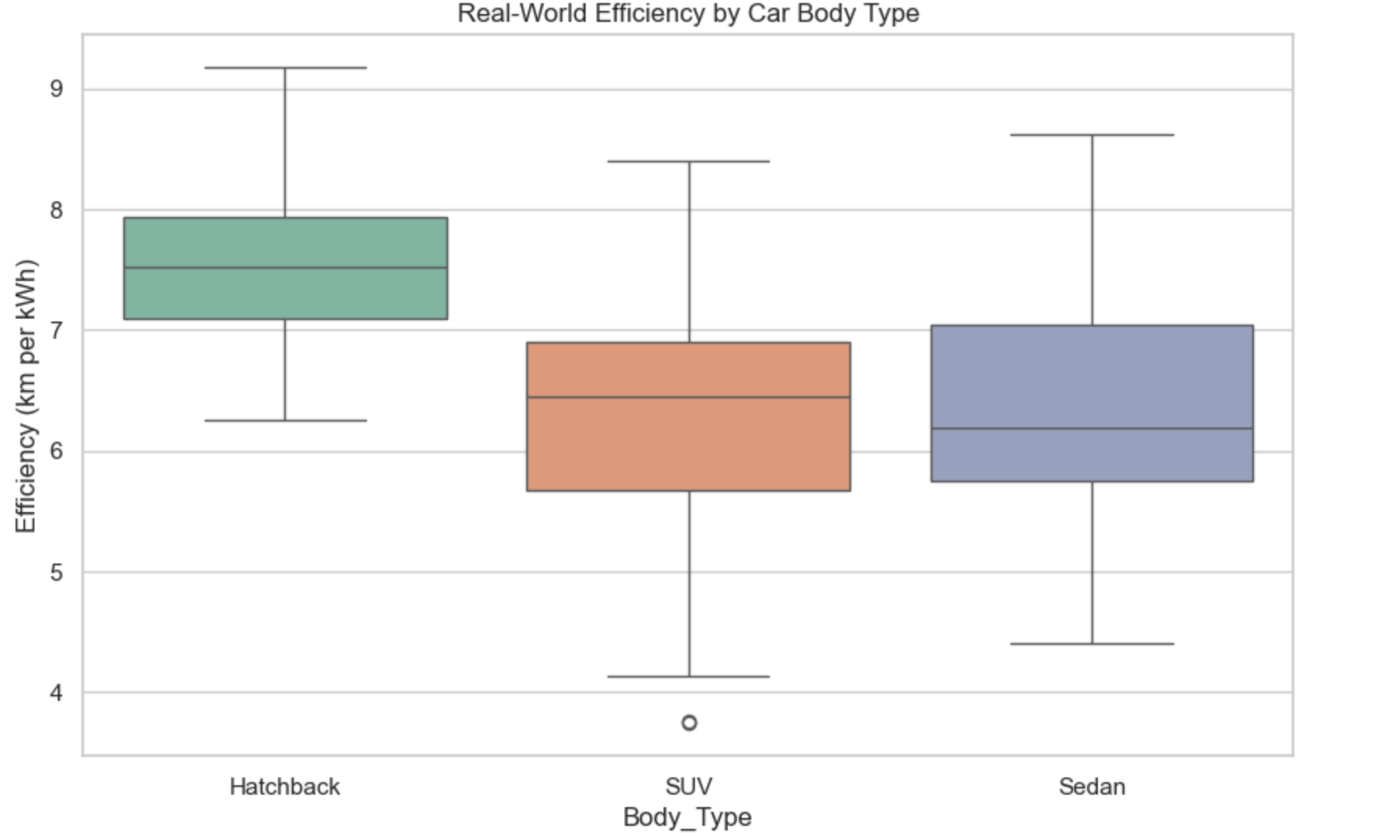
3. EV Car Market: Does Paying More Buy Efficiency?
The "Efficiency Gap": Analysis of 2025 models reveals that Premium EVs (>$80k) are often less efficient than Mid-Range models due to increased weight and performance batteries.
The "Speed Tax": While Premium cars cost more, they are the only ones unlocking "Ultra-Fast" charging (>150kW). Economy cars are largely restricted to slower speeds.
Conclusion: Customers paying for Premium are buying speed, not energy efficiency.

Slide 23
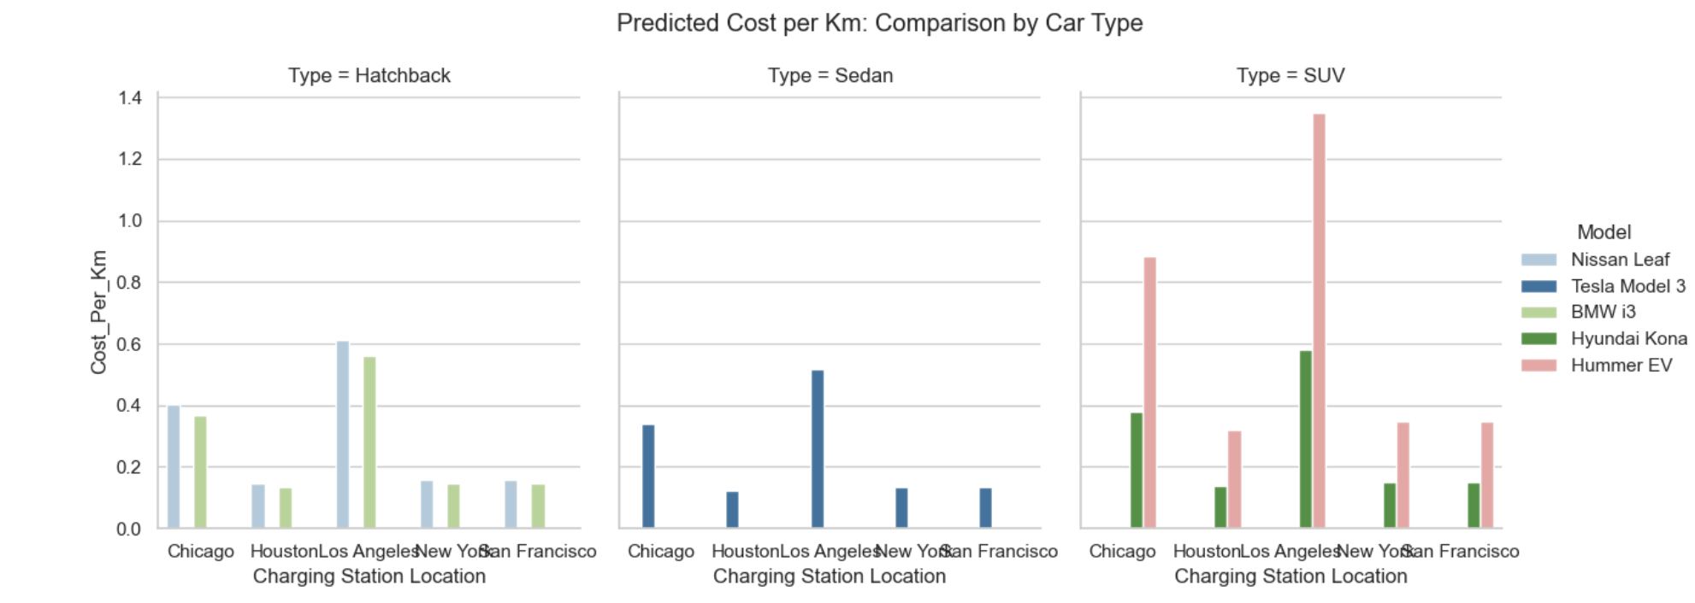
3. EV Car Market: "Cheapest Mile" Predictor
Cars
The Methodology: A hybrid model combining real-time city electricity rates (Stream 2) with vehicle-specific efficiency data.
The Prediction: Calculates the exact Cost per Kilometer for specific user scenarios.
Key Finding: In high-cost cities like New York, driving a "Hummer EV" costs 3.5x more per km than a "Nissan Leaf."
Value: Empowers users to choose vehicles based on running costs rather than just purchase price.

Slide 24
Conclusions and next steps
Company Name
Date
The charge point session data did not have a sufficient amount of credible data to derive robust and conclusions or patterns in the customer behaviours and pricing
Merge all core data frames at start of python code so the interactive filters work efficiently throughout the dashboard and are automated with any additional data - as below.
Source additional real world EV charge point session data from suppliers and connect to live APIs.
Source additional mapping data concurrent with session data to ensure locational data is accessible throughout the interactive dashboard for convenient viewing alongside pricing and availability stats.
Incorporate prediction models into the pricing and availability analyses and create customer interface.
Refine the EV car assessment to include more refined and extensive efficiency calculations across all models in the data set.

Slide 25
Thank you!
Company Name
Date
If you have any questions, contact:
samhsforrest@gmail.com

